Slide 1
amazon
External Review of Current Technology Strategies
Group 9
Notes:
Good Afternoon, we all know how the American tech multinational Amazon has evolved over the years from an online book retailer to spanning across multiple industries today. It has been leading the market with their tech competencies to scale different services to our fingertips, so we’re going to be presenting an external review of their current technological strategy, which has made Amazon a part of our everyday living.

Slide 2
01
Amazon Prime
02
3 Industries
03
E-commerce
Contents
04
Entertainment
05
Healthcare
06
Shared Aspects
07
Analysis
08
Recommendations

Slide 3


01
Amazon Prime
Notes:
We will be focusing on Amazon Prime, which is Amazon’s subscription service that was introduced to drive consumption for customers. It provides premium services for users to enjoy benefits across the platform and with different Amazon partnering companies.

Slide 4

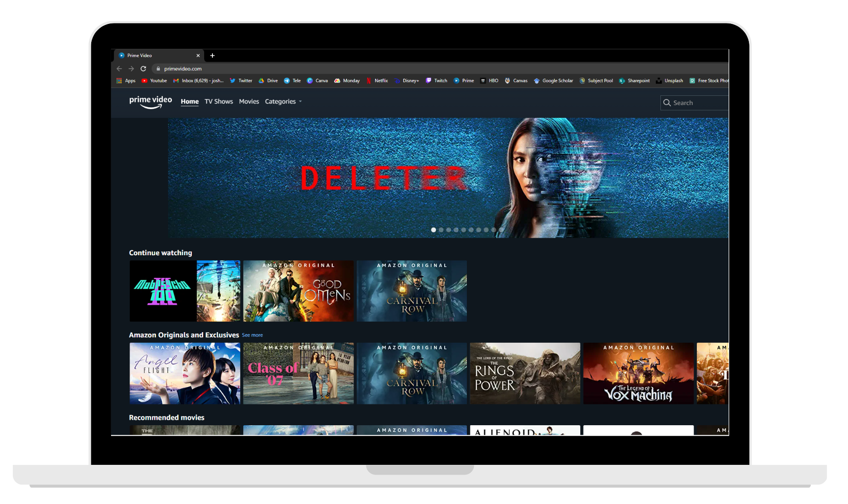

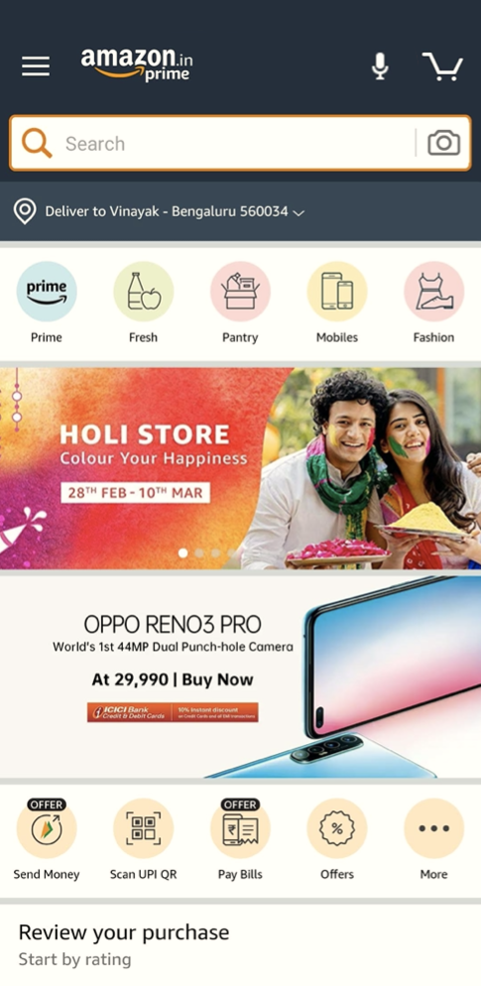
An Overview
Amazon Prime gives members access to shipping, shopping, streaming, reading, and other benefits.
E-commerce
Entertainment
Healthcare
Groceries
Reading
Events
Supplemental Memberships
And More…
Notes:
Prime provides users with access across multiple industries and segments with E-commerce, Entertainment, Healthcare, Groceries and other supplementary benefits, hence it has been one of the leading initiatives in the online subscription service market.

Slide 5
02
Industries

Slide 6
















Shopping
Entertainment
Lifestyle
Others
Notes:
Prime has various segments under its umbrella which can be classified under 3 major industries:
Ecommerce (i.e Shopping) with free delivery and prime day benefits
Entertainment including the exclusive shows, movies,music, gaming
Lifestyle, which is a new initiative with Amazon Care, Household
Others including the groceries, reading services and other benefits
And we will be evaluating their top 3 industries covering their E-commerce, Prime Gaming, Prime Video, Amazon Music and Amazon RX

Slide 7
03
E-Commerce

Slide 8
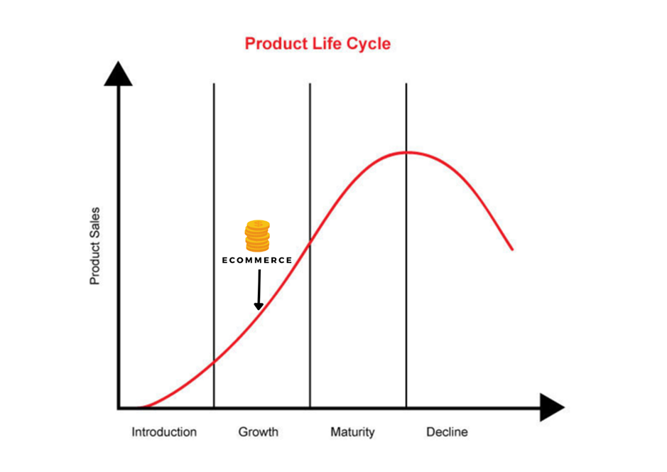
Market Focus: E-Commerce
Competencies: Service, Unique Product & Innovation
Appropriability Regime: Weak
Industry Stage
Notes:
At its very core, Amazon Prime is a service that is founded on the E-commerce market, which sees a growing market but with a weak appropriability regime.

Slide 9
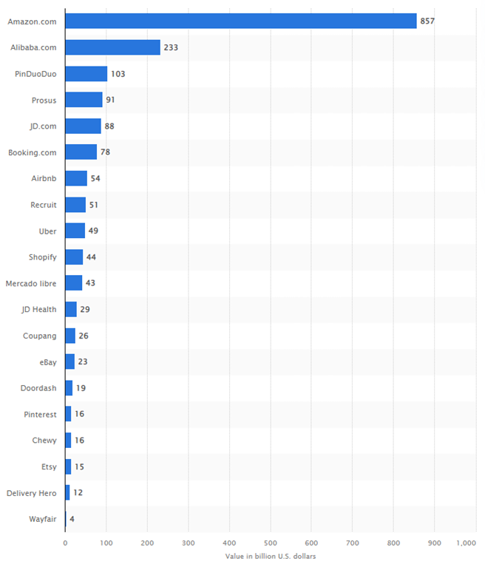

E-Commerce Competitors
The E-Commerce space is heavily challenged by Competitors.
Main Competitor
Statista, 2023
Notes:
The e-commerce space is generally heavily dominated by competitors, with the main competitor of Amazon being Alibaba.

Slide 10
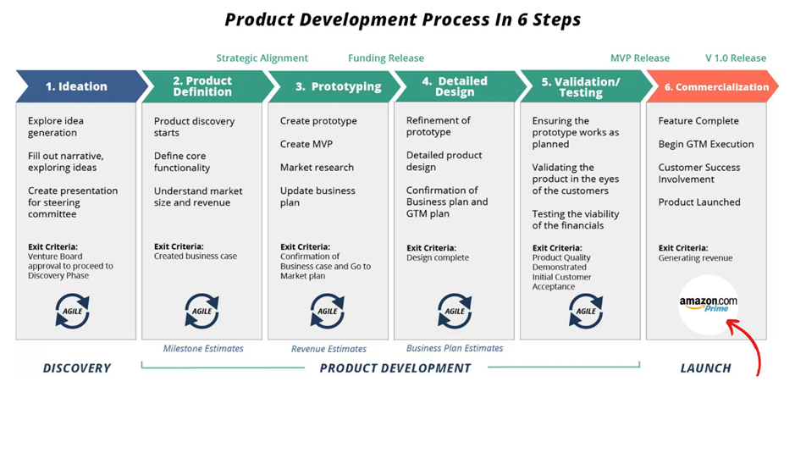
The E-Commerce Product
Stage of Product Development
Notes:
In terms of product development, amazon as an e-commerce product has reached the commercialisation stage, being a viable product to be used by all consumers.

Slide 11

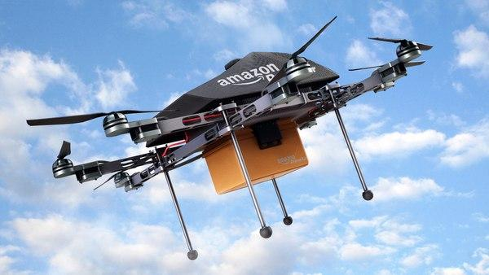
E-Commerce Innovations
Source of Innovation include:
Automation → Autonomous robots
Process Improvements
Supply Chain and Inventory Management
Usage of Robots for Improved Inventory Speeds
Usage of Drones for Efficient Deliveries
Notes:
Amazon E-Commerce continues to pursue innovation in the form of innovation for improve inventory speeds and drones for efficient deliveries.

Slide 12
Evaluation of E-Commerce
Evaluation
Utilisation of complementary assets & relations to increase the value of primary services & products.
Notes:
All in all, e-commerce should continue to use complementary assets and relations in order to better increase the value of primary services and products against its competitors

Slide 13
04
Entertainment
Notes:
Moving on to entertainment

Slide 14

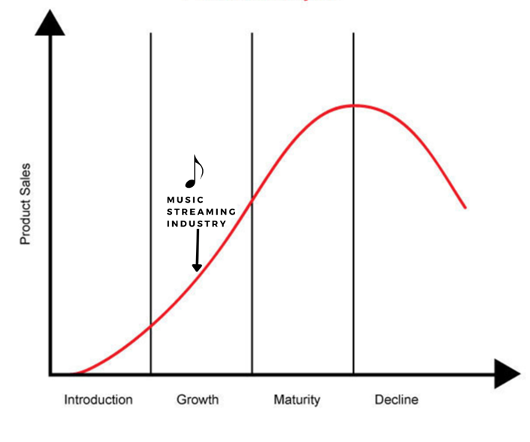
Market Focus: Music Streaming
Competencies: Service, Unique Product & Innovation
Appropriability Regime: Moderate
Industry Stage
Notes:
Amazon Music is found in the growth stage, with a moderate appropriability regime

Slide 15
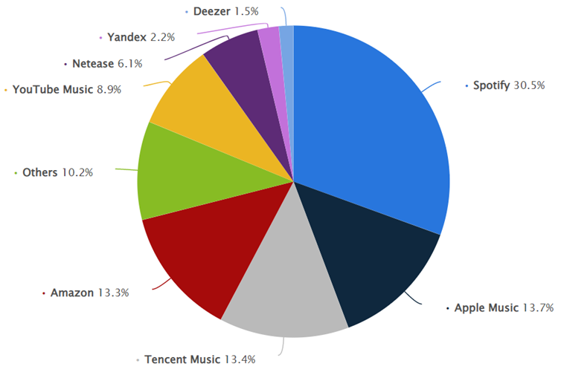
Music Competitors
The Music space is heavily challenged by Competitors.
Statista, 2023
Notes:
Similarly, Amazon music faces serious competition from incumbent firms like Spotify and Apple Music.

Slide 16



Music Competitors
Main Competitors include:
Notes:
In the industry, main competitors include tencent music, spotify and apple music.

Slide 17
Potential Changes
Music streaming platforms are becoming audio entertainment platforms.
Notes:
In the industry, potential changes include these music streaming platforms becoming audio entertainment ones instead.

Slide 18



Alliances
Label Partner | Revenue (2022) | Growth (From Previous Year)
Sony Music | $9.12b USD | 24.4%
Universal Music Group | $11.14 USD | 21.6%
Warner Music Group | $5.92b USD | 11.7%
Notes:
With alliances like Sony, Universal and Warner Brothers having strong growth year on year, it is clear that Amazon Music has established strategic partnerships in the music industry

Slide 19
Appropriability Regime
Intellectual Property
Licensing
Copyright
Site Aesthetics
Appropriability Regime: Moderate
Streamed Music
High Payment Gateways (Licensing)
Amazon Music Live
Copyright
Exclusive Content
Licensing
Exclusive Rights
Notes:
Intellectual property mainly stems from licensing and copyright. Its moderate approp regime suggest that licensing and copyright can only protect certain elements but not the entire service..

Slide 20
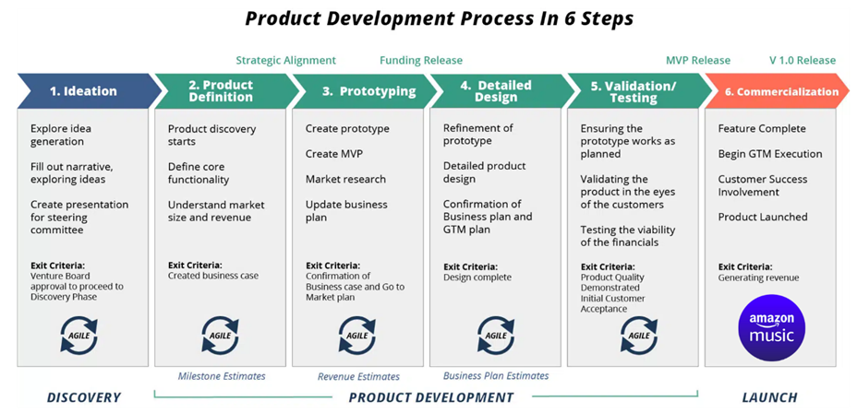
The Music Product
Stage of Product Development
Notes:
In terms of product development, amazon as a music product has reached the commercialisation stage, being a viable product to be used by all consumers.

Slide 21
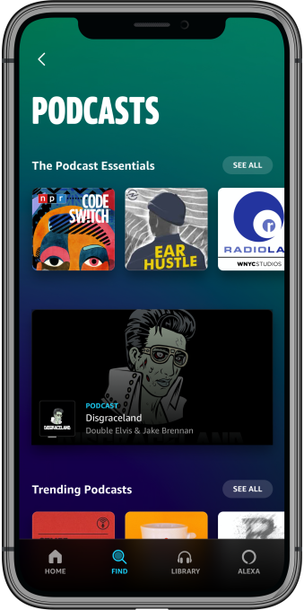

Music Innovations
Source of Innovation include:
Podcasts
Amazon music LIVE
Podcasts
Unique Amazon Music LIVE

Slide 22
Evaluation of Music
Evaluation
Amazon differentiates themselves in the music streaming industry by signing exclusive content and creating content of their own, shifting the platform to an audio entertainment hub.

Slide 23

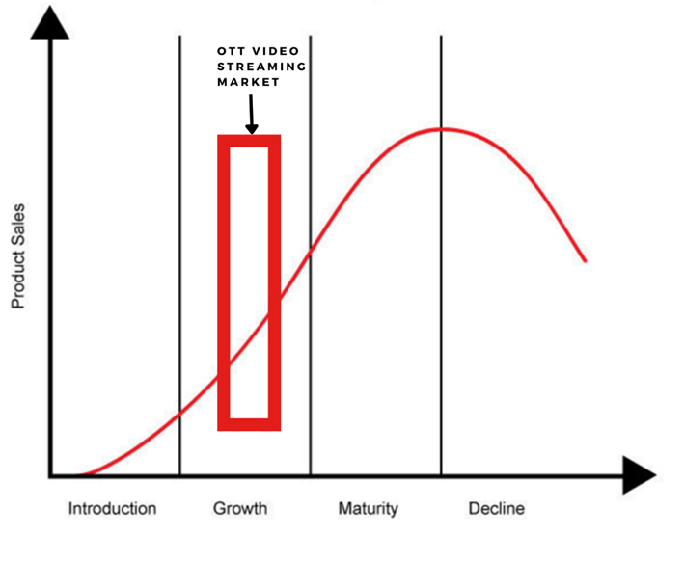
Market Focus: Over-The-Top Streaming → Video Streaming
Competencies: Quality Control, Unique Product & Innovation
Appropriability Regime: Moderate
Industry Stage
Notes:
Amazon Prime Video is found in the growth stage, with a moderate appropriability regime

Slide 24
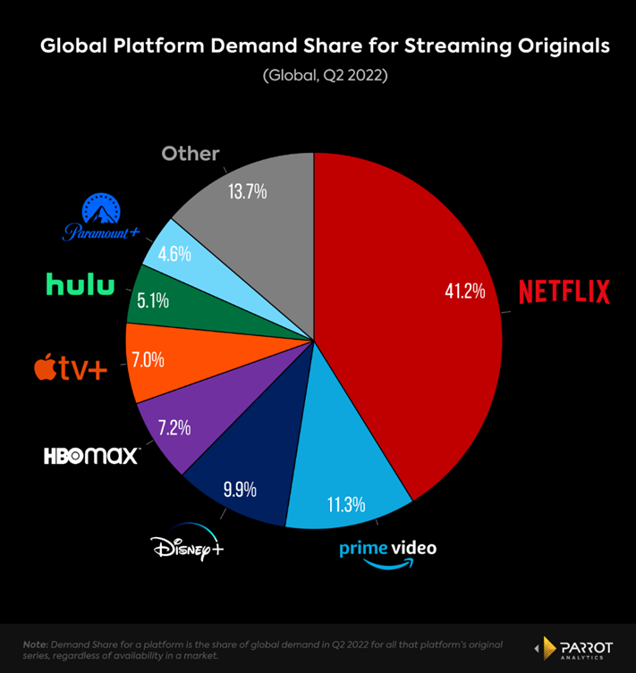
Video Competitors
The Video/Streaming space is heavily challenged by Competitors.
Parrot Analytics, 2022
Notes:
Similarly, Amazon video faces serious competition from incumbent firms like Netflix and up and rising Disney plus.

Slide 25


Video Competitors
Main Competitors include:
Notes:
Similarly, Amazon video faces serious competition from incumbent firms like Netflix and up and rising Disney plus.

Slide 26
Potential Changes
There will be an increased focus on exclusive & original content.
Notes:
However, with an increased focus towards exclusive and original content, Amazon Video has to be ready for change.

Slide 27





Alliances
Company | Revenue | Growth rate
National Football League (NFL) | $17.19b | 41%
Corus Entertainment | CAD$1.59m | -
Paramount | $30.1b | 5.49%
Warner Bros. Discovery | $2b | 4%
Lionsgate | $894m | 25%
Notes:
With alliances like NFL, Paramount and Warner Brothers having strong growth year on year, it is clear that Amazon Music has established strategic partnerships in the video industry

Slide 28
Appropriability Regime
Intellectual Property
Licensing
Copyright
Site Aesthetics
Appropriability Regime: Moderate
Streamed Movies & Shows
Licensing
Amazon Originals
Copyright
Exclusive Content
Licensing
Exclusive Rights
Notes:
Intellectual property mainly stems from licensing and copyright. Its moderate approp regime suggest that licensing and copyright can only protect certain elements but not the entire service.

Slide 29
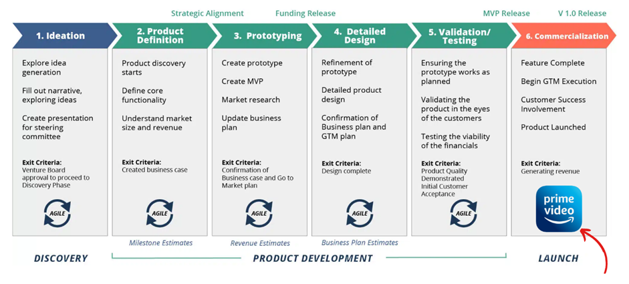
The Video Product
Stage of Product Development
Notes:
In terms of product development, amazon as a video product has reached the commercialisation stage, being a strong product to be used by all consumers.

Slide 30
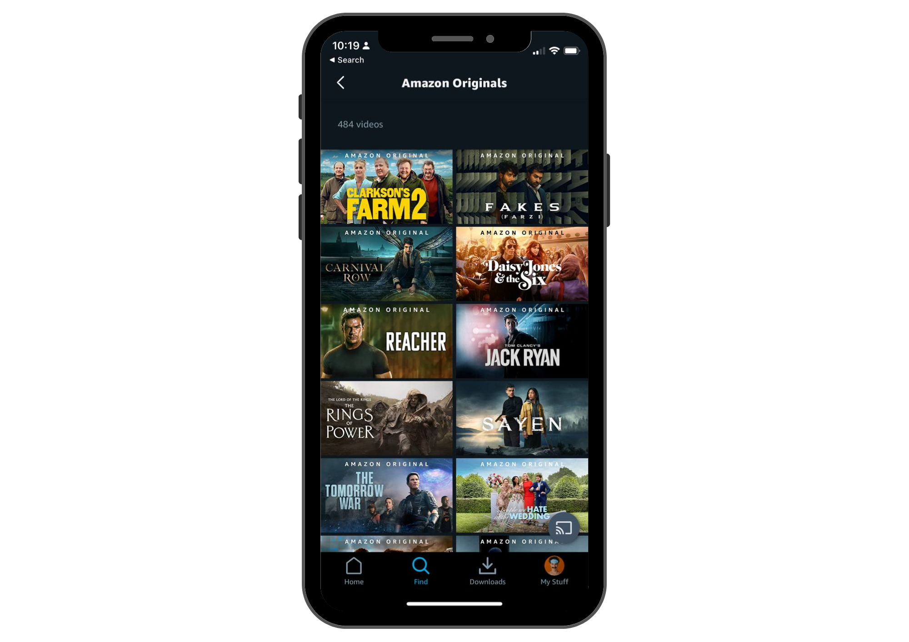
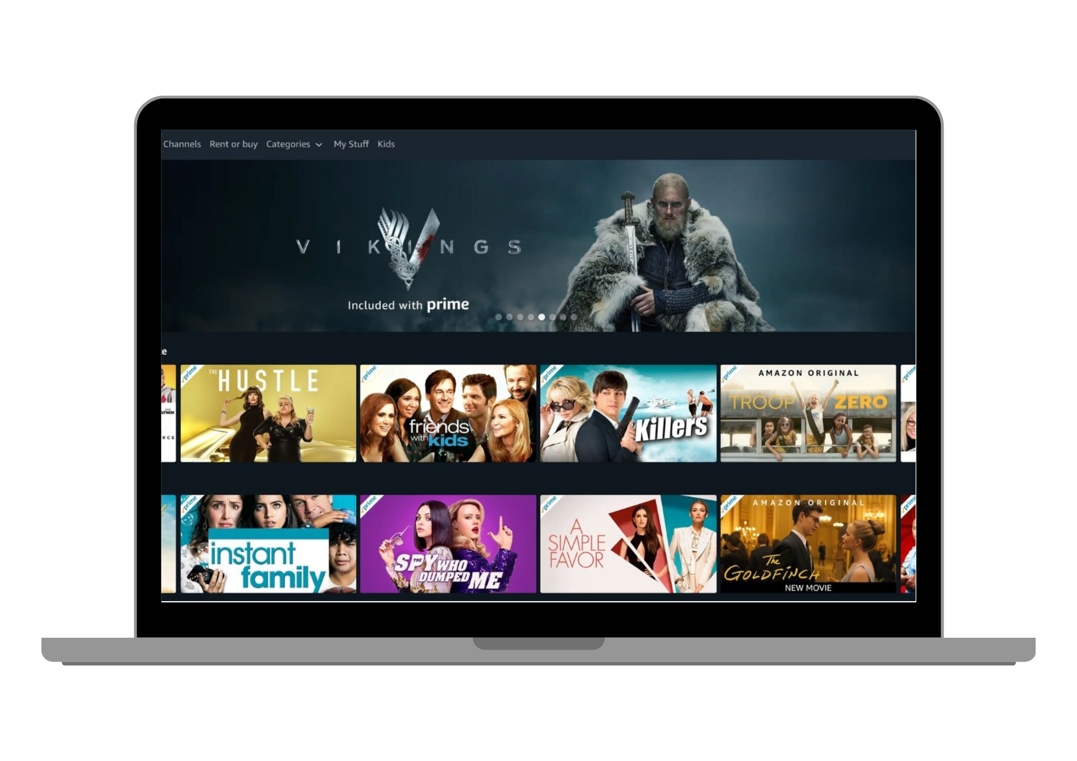
Video Innovations
Source of Innovation include:
Amazon Originals
Amazon Originals
Notes:
Innovations include Amazon Originals that produce original content for viewers.

Slide 31
Evaluation of Video
Evaluation
Prime Video uses platform unique content to stand out in the market, coupled with smart user habit machine learning & algorithms.
Notes:
All in all, Prime Video’s unique and exclusive content allows it to stand out in the market, alongside the smart algorithms and machine learning that tailors to specific customers wants.

Slide 32
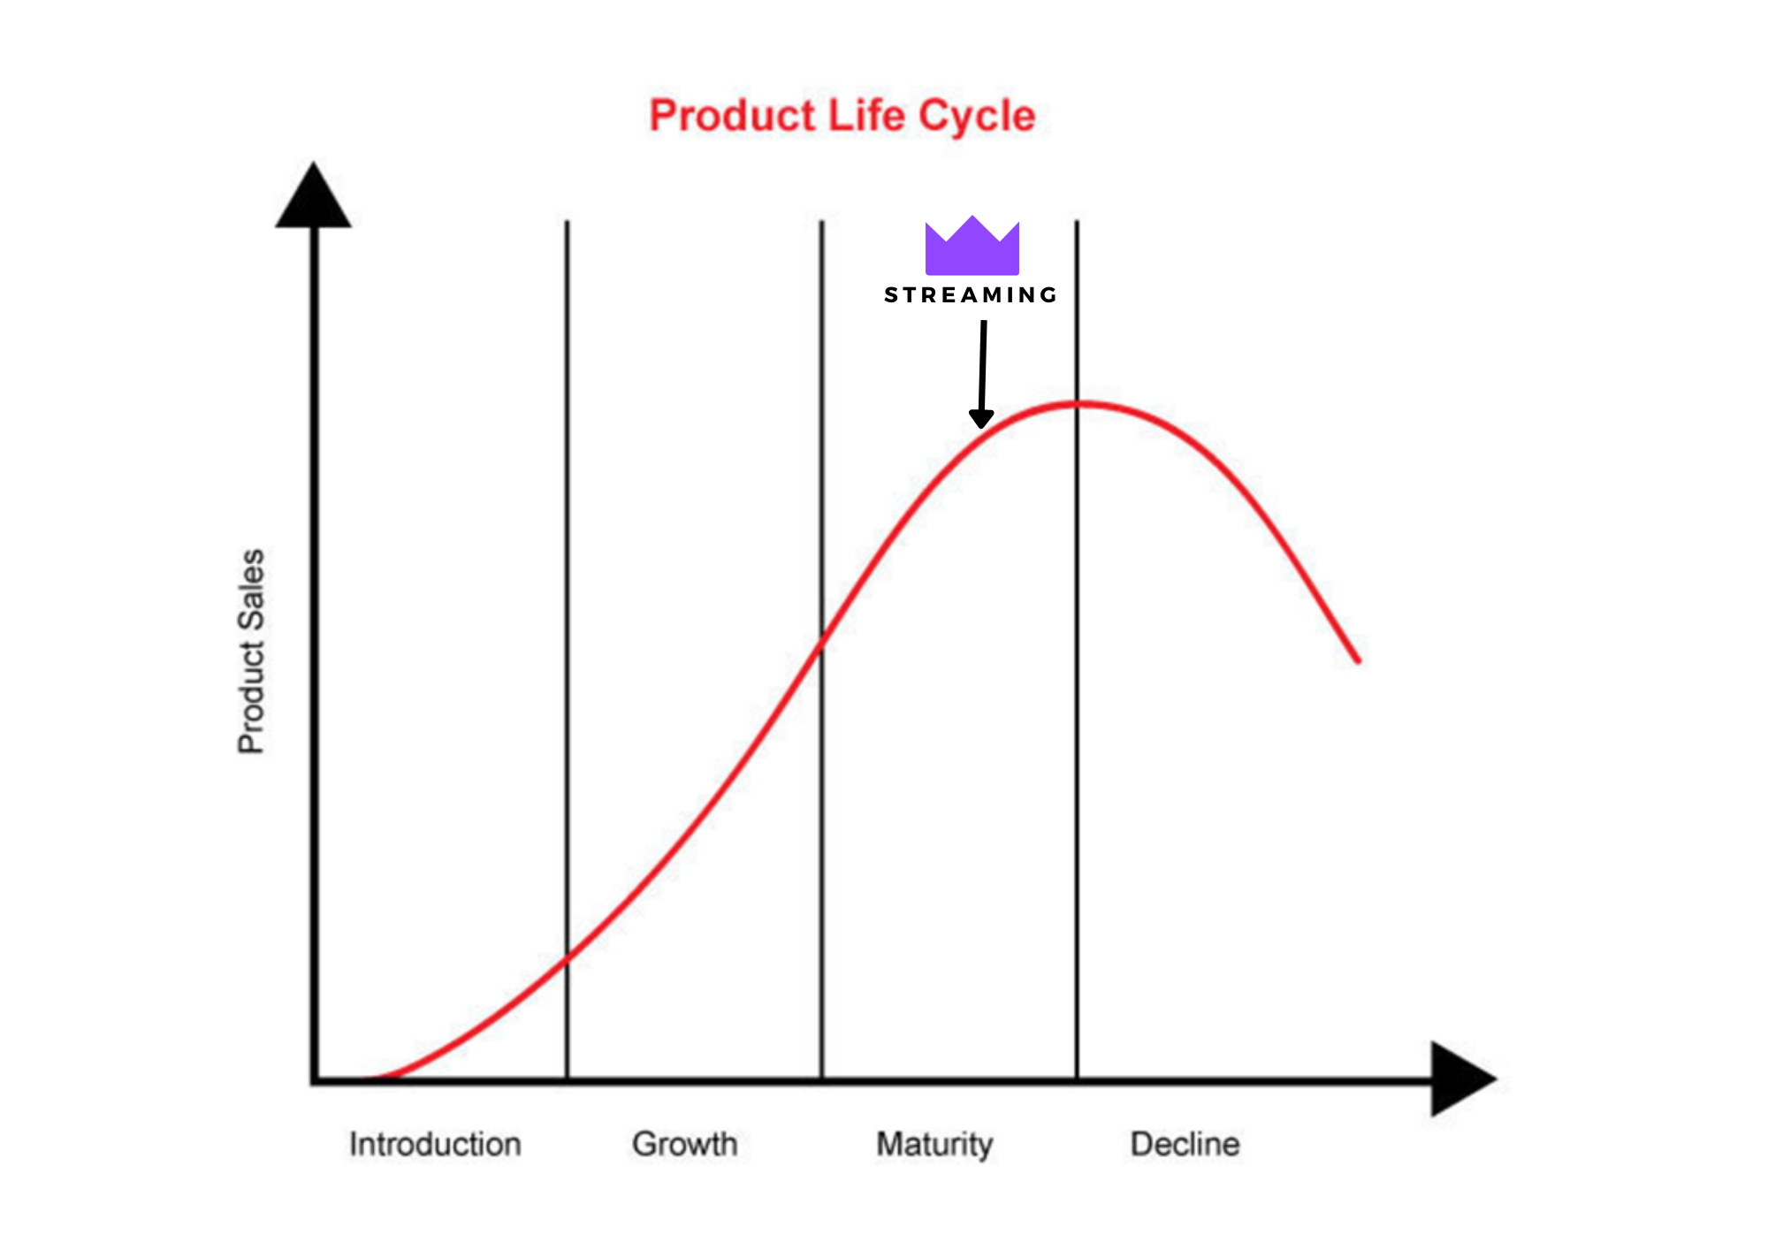
Market Focus: Gaming - Live Streaming
Competencies: Service, Unique Product & Innovation
Appropriability Regime: Weak
Industry Stage
Notes:
Amazon Prime Gaming is found in the growth stage, with a weak appropriability regime

Slide 33
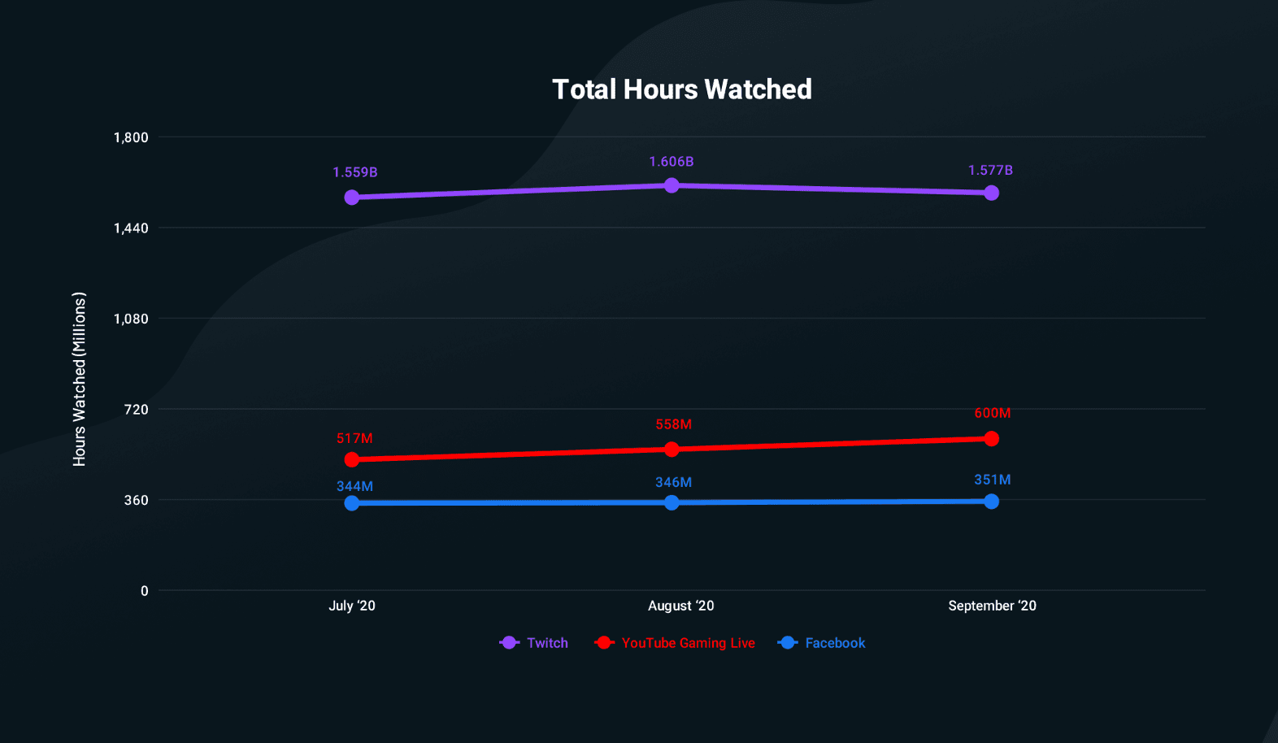
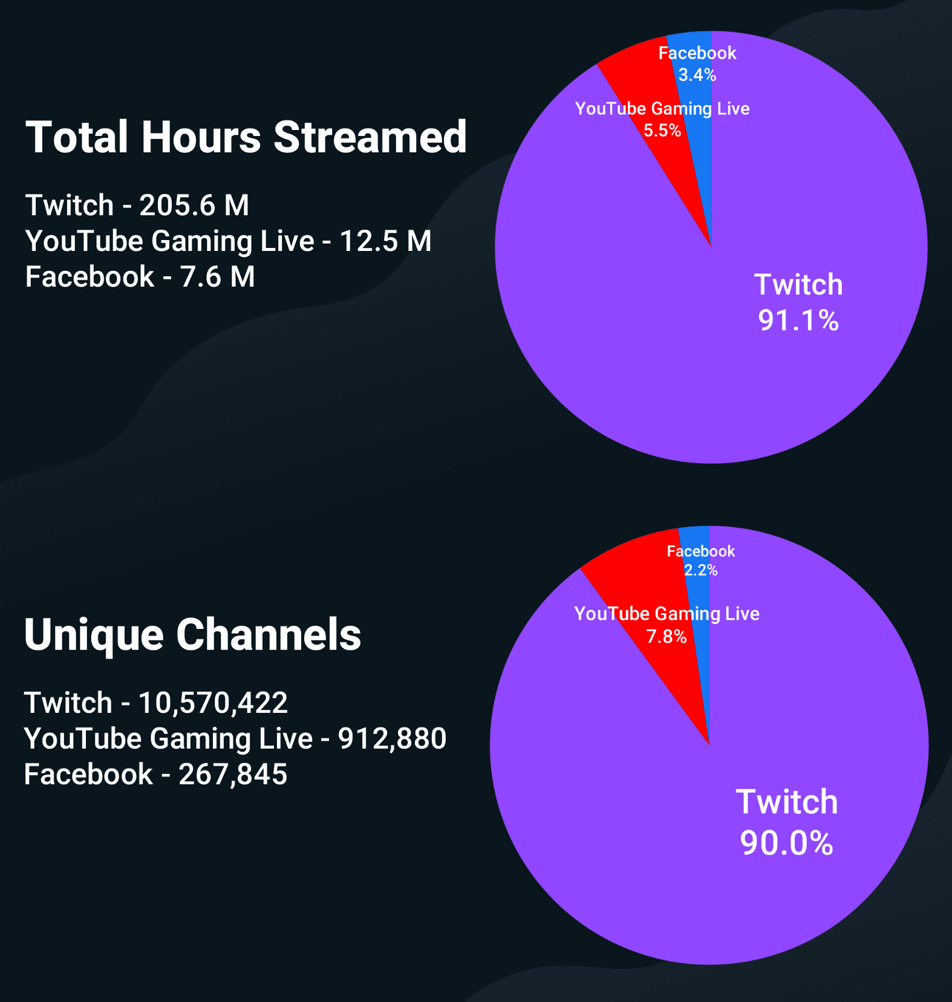
Game Streaming Competitors
Prime Gaming leads in the game live streaming against its Competitors.
Digital Information World, 2020
Notes:
In terms of hours watched and streamed, twitch prime gaming surpasses all competitors in the field, such as YouTube and Facebook live
https://www.statista.com/statistics/1275802/top-gaming-services-subscription-rate-among-gamers-usa/

Slide 34
Potential Changes
New rival streaming platforms that do not have as strict requirements and greater revenue sharing.
Notes:
However, it is crucial to note that upcoming rival platforms such as Kick with greater revenue sharing and more lenient requirements may eat into their market.

Slide 35



Alliances
Company | Revenue | Growth rate
Riot Games | $1.5b | 10.4%
EA Sports | $1.8b | 5.14%
Epic games | $5.7b | 12.94%
Notes:
Amazon partners with established gaming companies like Riot, EA and Epic games, owing to its growth overtime.
https://esportsinsider.com/2021/10/amazon-prime-riot-games

Slide 36
Appropriability Regime
Intellectual Property
Licensing
Copyright
Site Aesthetics
Appropriability Regime: Weak
Streamed Games
Licensing
Amazon Game Studios
Copyright
Exclusive Content
Licensing
Exclusive Rights
Notes:
Intellectual property mainly stems from licensing and copyright. Its weak approp regime suggest that licensing and copyright can easily be replicated by others, evident with the plenty of competitors that exist.

Slide 37
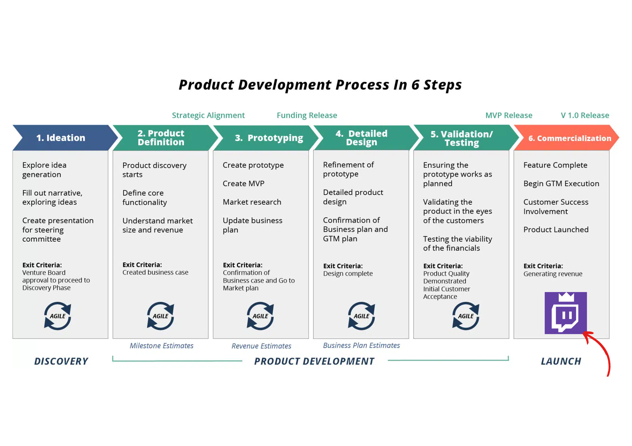
The Gaming Product
Stage of Product Development
Notes:
In terms of product development, amazon as a gaming product has reached the commercialisation stage, being a viable product to be used by all consumers.

Slide 38
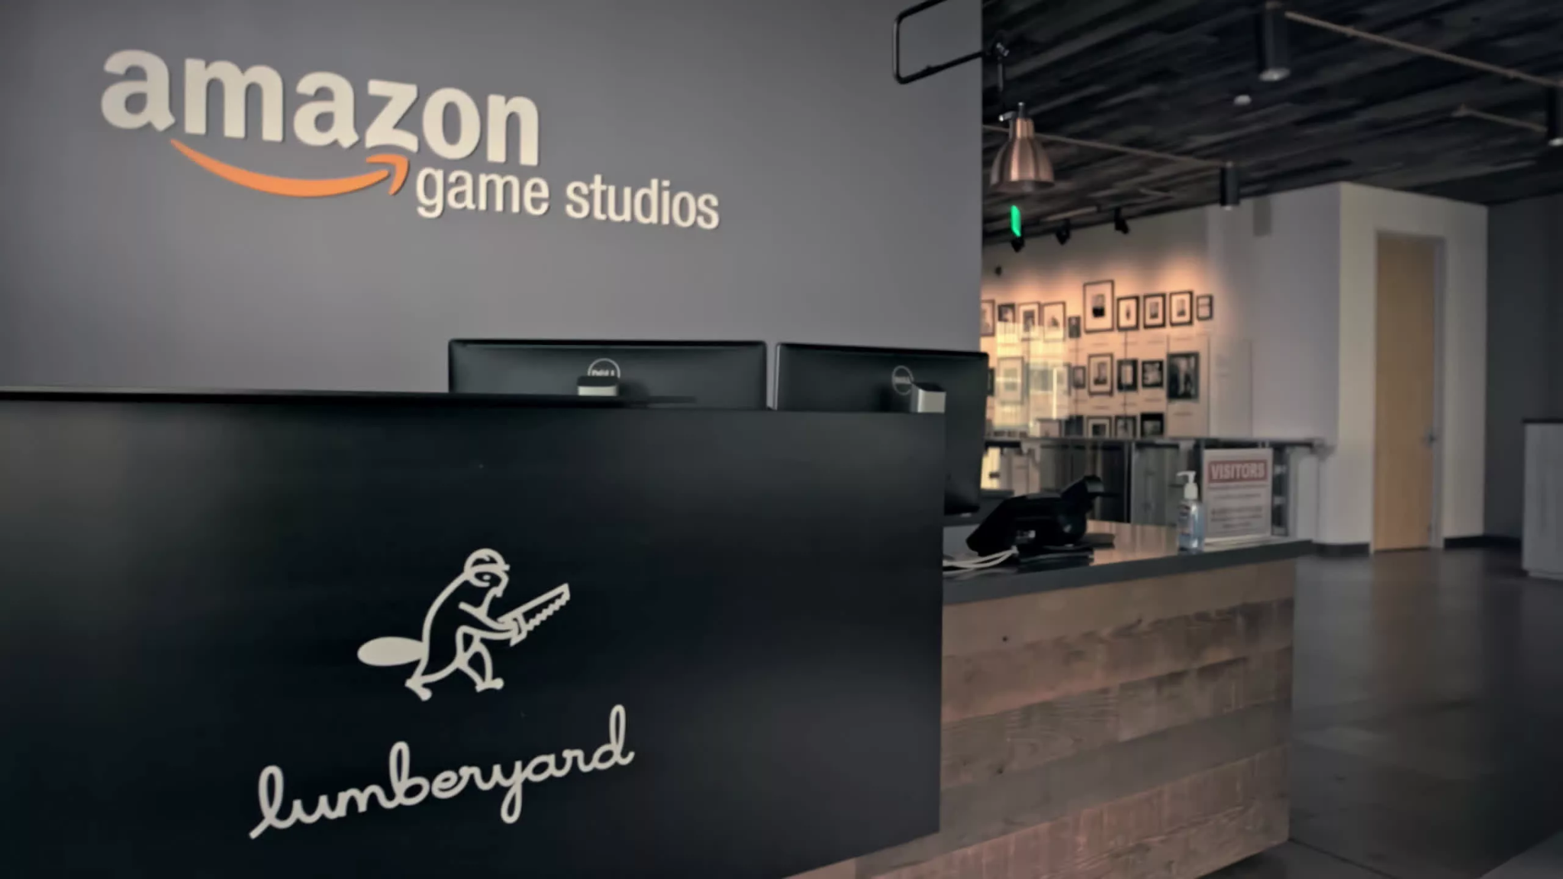
Gaming Innovations
Source of Innovation include:
Amazon Game Studios
Amazon Game Studios
Notes:
Innovations include Amazon Game Studios which produces its own games for users.
https://www.amazongames.com/en-us

Slide 39
Evaluation of Gaming
Evaluation
Prime Gaming is one of Amazon Prime’s biggest success due to the acquisition of Twitch, amassing a large installed base, and is the largest go-to streaming platform for gamers and viewers.
Notes:
In sum, Prime Gaming is one of Amazon Prime’s biggest success due to the acquisition of Twitch, amassing a large installed base, and is the largest go-to streaming platform for gamers and viewers.

Slide 40
05
Healthcare

Slide 41
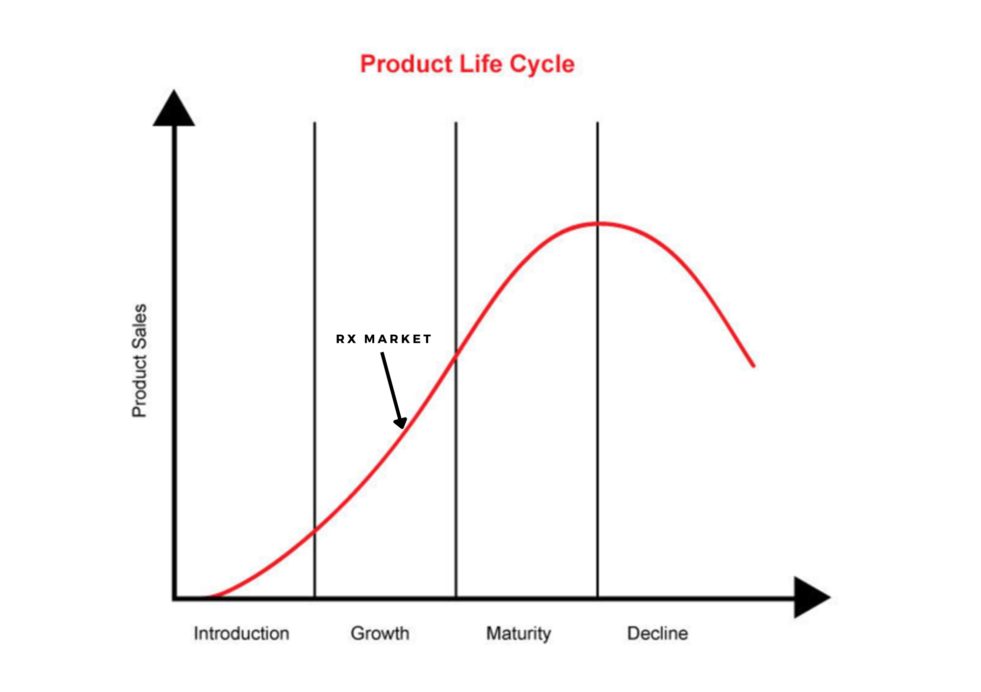

Amazon RX
Market Focus: Drug prescription
Competencies: Logistics, in-house production
Appropriability Regime: Moderate
Industry Stage

Slide 42
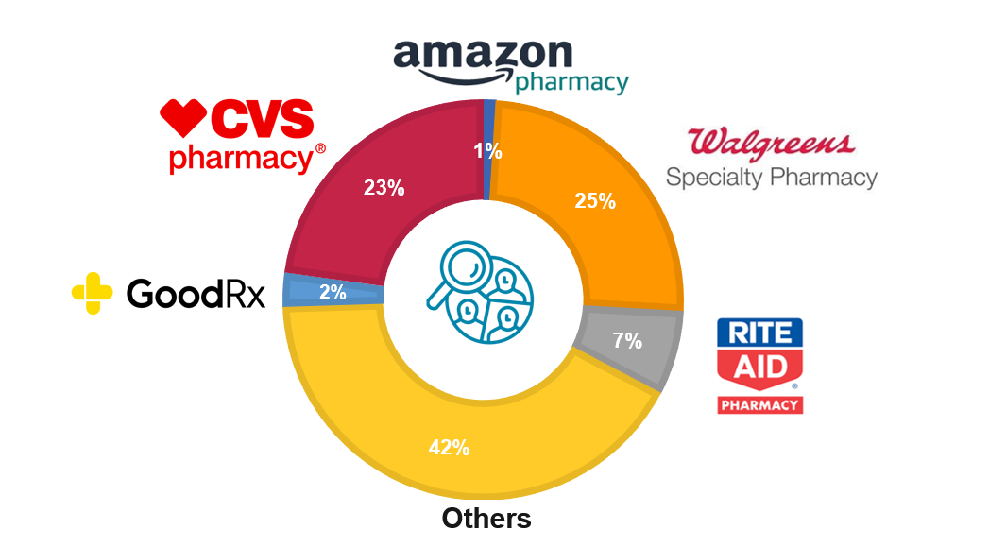
Amazon RX Competitors
The Amazon Care space is heavily challenged by Competitors.
ScrapeHero , 2022

Slide 43
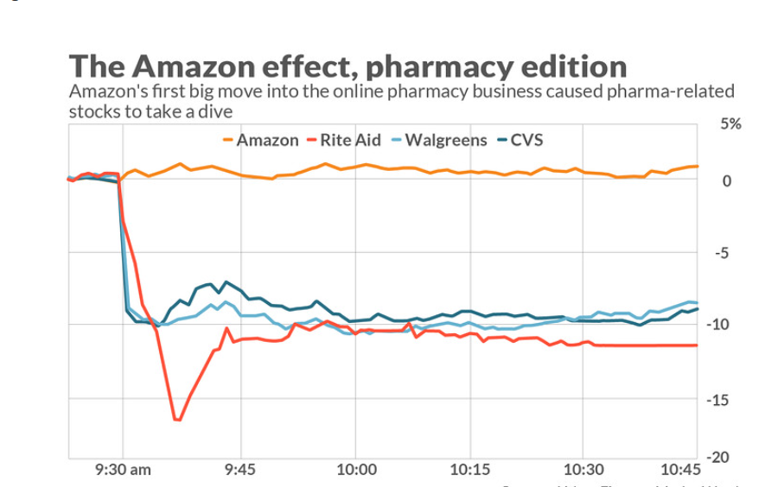
The Amazon RX Effect
MarketWatch, 2020

Slide 44
Potential Changes
Amazon RX could expand its services to international markets to reach a wider customer base and gain a competitive advantage over traditional brick-and-mortar pharmacies

Slide 45




Alliances
Company | Synergies
BlueCross BlueShield | Offers various discounts plans offered to BlueCross Blueshield plan clients. Tackles affordability for prescription drugs
Apollo Hospitals | Expansion in India Development of their online-pharmacy business
Kroger, Winn-Dixie Pharmacy and other retail pharmacy | Partnership to offer savings on various prescription drugs.. Skip the line at pharmacy and enjoy free deliveries of drugs and refillment.

Slide 46
Appropriability Regime
Intellectual Property
Medical License
Software systems and tools
Pharmaceutical patents
Appropriability Regime: Moderate
Amazon Rx Pass
Software systems and tools
Medical License
Logistics
Software systems and tools
In-house production
Medical license
Pharmaceutical Patents

Slide 47
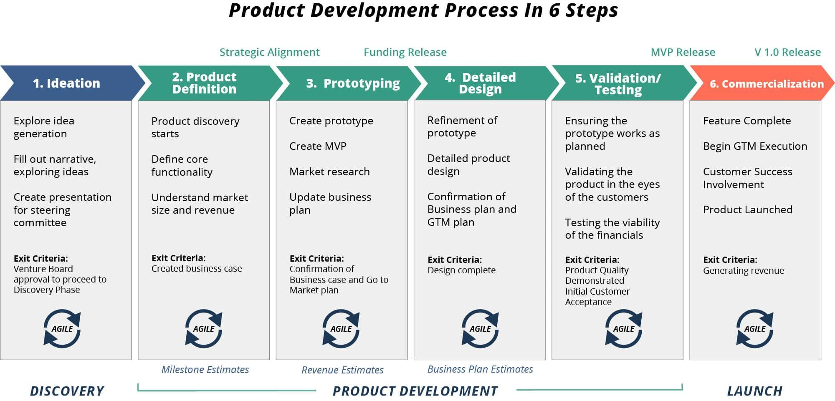
The Amazon RX Product
Stage of Product Development

Slide 48
Amazon RX Innovations
Source of Innovation include:
Technology: Amazon is known for its technological innovation and is constantly looking for ways to use technology to improve its services. Amazon RX should use its technology to make the ordering and delivery of medications more efficient and convenient.
Customer data: Amazon has access to a vast amount of customer data, including purchase history, search history, and customer feedback. This data can be used to understand customer needs and preferences and to develop new products and services.
Price transparency: Amazon RX offers price transparency, making it easy for customers to compare prices and choose the best option for them. This transparency has the potential to disrupt the traditional pharmacy industry and drive innovation in pricing and competition.

Slide 49
Evaluation of Amazon RX
Evaluation
Amazon Pharmacy and Amazon Rx core strength lies in their ability to shift towards the digitalization of their platform.
They should use their logistics advantage and their database to improve the efficiency and productivity of the drugs distribution.

Slide 50
06
Shared Aspects

Slide 51
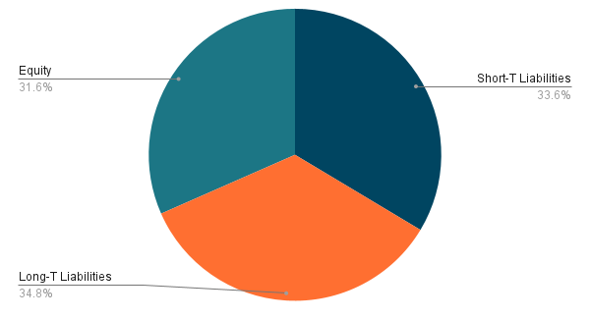
Finances of Amazon
Capital Structure
Financial Summary
Balance Sheet (2022), in millions
Assets: $462,675
Liabilities: $316,632
Equity: $146,043
Net Income, in millions
2021: $2,906
2022: ($5,833)
Cash Flow, in millions
2021: $36,477
2022: $54,253

Slide 53
Finances: Implications
Balanced Short-term & Long-term Liabilities: Compromise policy & Middle Level Long-Term Financing (Low, 2022). Good balance of liabilities.
Low Current Ratio:
Low inventory (23%), indicates good management of current assets
Cash Flow Implications:
3 Months Ended, $54,253m which is a third of the short-term liabilities. Likely able to borrow short-term.
Net Income 2022:
Loss of $5,833m due to an investment in Rivian. However, Sales reached a 9% growth. Likely able to borrow long term money since losses can be seen as a one off incident.

Slide 54
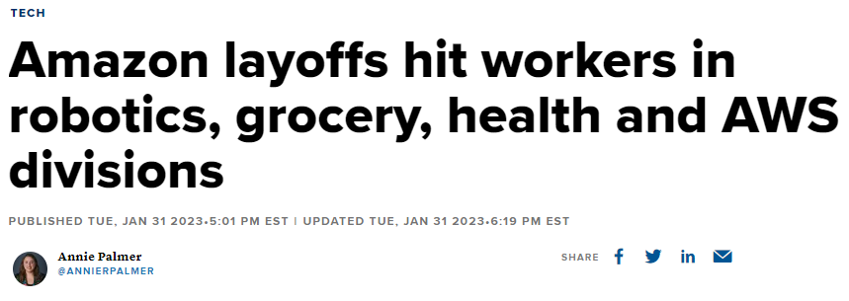
Staffing Issues of Amazon
Statistics:
Turnover Rate: 150%
Robot Addition: 1000 per day
Reasons:
Post-COVID Changes
Automation
Low Job Progression

Slide 55
Evaluation of Staffing Issues
Evaluation
Amazon is contracting their labour force due to the drop in excess cash with the pandemic, and with automation on the rise.

Slide 56
07
Analysis

Slide 57
A Review of:
Industries (in isolation) are performing well and are growing
Strong and purposeful alliances with stable, growing companies
Key Competency: Innovation & Service
Moderate Strength Appropriability Regime

Slide 58
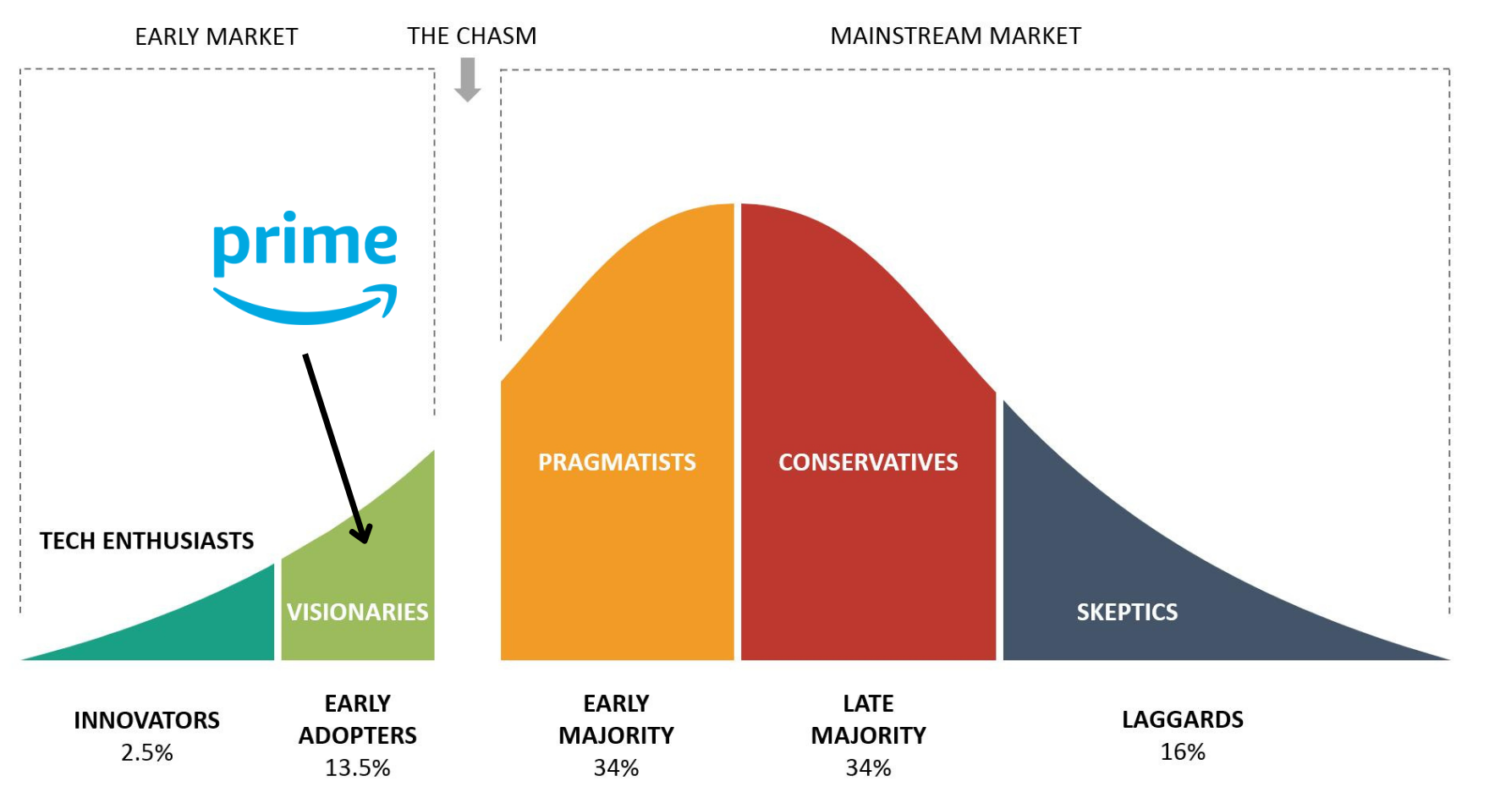
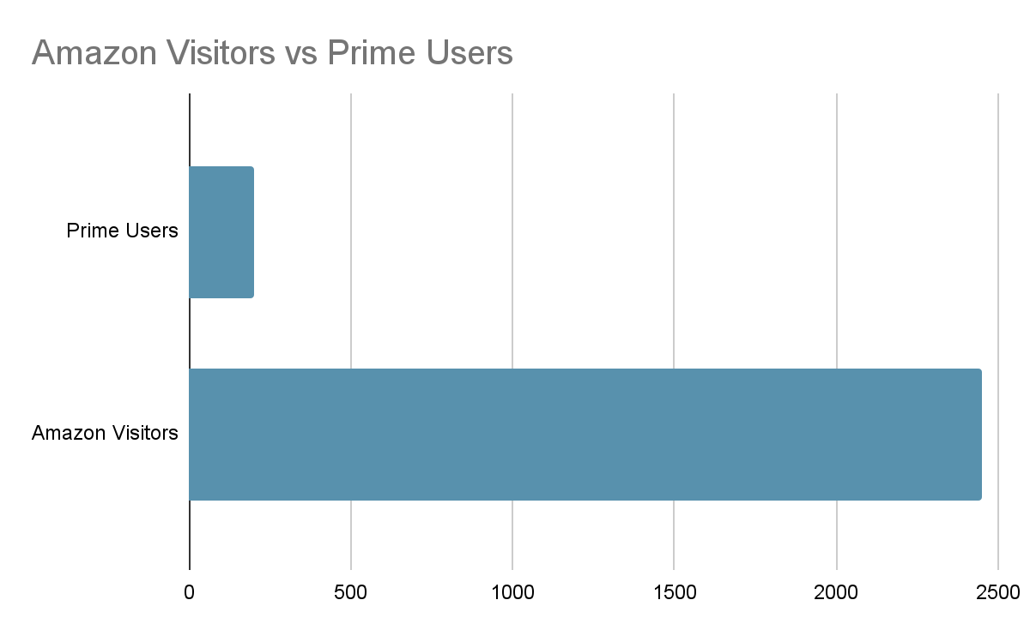
How Can Prime Improve?
User Base:
75% of Prime users are in the USA
200m Prime users
2.45b unique monthly visitors
ONLY 10% Adoption

Slide 59
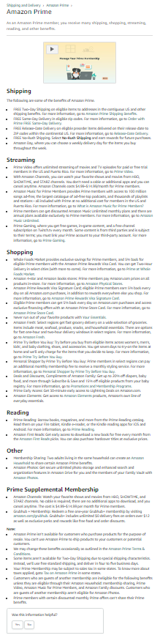

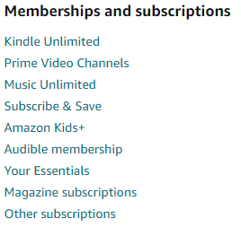
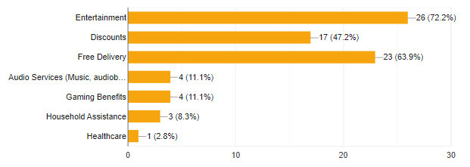
How Can Prime Improve?
Self Competition:
Implications:
Amazon is using an installed base + complementary asset strategy.
No clear definition of Amazon Prime’s value.
Creates barriers of customer resistance.
Paradox of choice: Too many varieties of options lead to no decision at all.
Customer Survey:

Slide 60
What is Prime’s Issue?
Amazon Prime is a poorly defined product, to consumers, that faces self cannibalisation from other aspects of Amazon creating user resistance.

Slide 61
08
Recommendations

Slide 62
Recommendations
01
Compile All Offerings
Into a Single Offer

Slide 63
Compile All Offerings Into a Single Offer
+
Simplify the Customer Experience
Too many different “offers” available for customers, combining all offers would allow for a one common package that Customers are buying into.
+
Reduces Confusion
Collating all “offers” provides a clear image of Amazon Prime, preventing confusion over the different prices offered across different segments

Slide 64
Recommendations
02
Focus on the Western Countries Before The Rest of The World

Slide 65
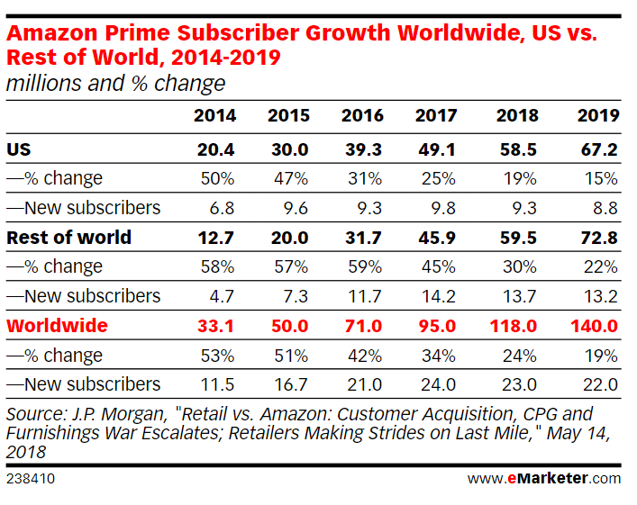
Focus on Western Countries
+
Larger Market Share
75% customers are Western, given the brand of Amazon and hence Competitive Advantage it has, Amazon Prime will be better able to capture consumers in the US, UK, and Middle East.

Slide 66
Recommendations
03
Introduction of Exclusive Bundles for Target Groups

Slide 67
New Exclusive Bundles
+
Targeted Products
Targeted products at specific demographic groups would increase the product’s attractiveness and fit to specific needs.
Amazon Family
Amazon Prime
Promotions on Amazon Care and E-Commerce products
Family Day → Exclusive discounts for Families
Promotions for Prime Gaming and Music
Prime Day (in existence) → Exclusive discounts across Amazon
$19.99
$12.99

Slide 68
Thanks!

Slide 69
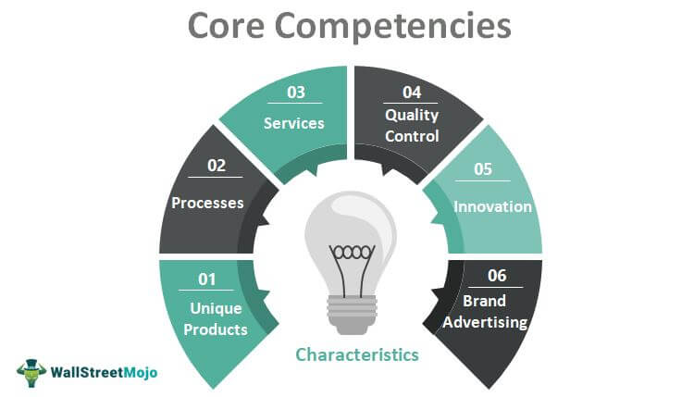
Key Competencies

